Slide 1
Volunteer Management System
Presented by Dio Phung

Slide 2
Content
Introduction
Overview of Requirements
Project Risks
Project Strategies
Project Plan
Project Progress
Management Challenges
High Level Architecture
Transition to Next Stage
Q & A

Slide 3

Introduction
Volunteer Management System

Slide 4
Introduction – Organisation Background
Objective of Non-Government Organisation (NGO) – Eliminate poverty
Has grown tremendous over the years which attracts more volunteers.
A need to coordinate and manage the volunteers.
Manual handling of paperwork and volunteers requires lots of work and limits the efficiency of the organisation.

Slide 5
Introduction – System Objective
To provide an integrated system with the aim of addressing the problems of volunteer communication, documentation, recruitment and retention.

Slide 6
Overview Of Requirements
Volunteer Management System

Slide 7
Overview of Requirements
Volunteer Management
Staff Management
Project Management
Itinerary Management
Administration

Slide 8
Project Risks
Volunteer Management System

Slide 9
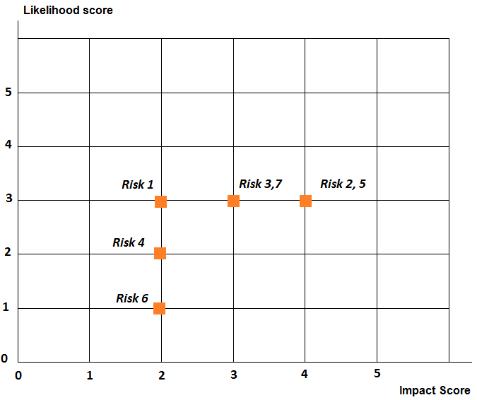
Project Risks – Prioritized list
# | Risk Item | Impact | Likelihood
1 | No Project management skills set | 2 | 3
2 | Team member may not be available during the project timeline | 4 | 3
3 | Customer may lose commitment and availability | 3 | 3
4 | Not domain expert and not much knowledge in Volunteer Management | 2 | 2
5 | Not all team member have technical knowledge for: Presentation Layer (YUI2, DWR) Data Access Layer (Hibernate) | 4 | 3
6 | Not sure of the User Interface requirements | 2 | 1
7 | Portability risk : system need to support multiple browsers, multiple platforms | 3 | 3

Slide 10
Project Risk – Risk Management Techniques
S/N | Risk Item | Control Type | Specific Details
1 | No Project management skills set | Risk Localization Risk Insurance | Gain PM skills by on the job training Shadow a few people to work with common tasks and knowledge
2 | Team member may not be available during the project timeline | Risk Insurance Risk Avoidance | Each key project role will have backup personnel Schedule carefully to anticipate all unavailability upfront
3 | Customer may lose commitment and availability | Risk Avoidance Risk Transfer Risk Insurance | Look for alternative customer Appoint team member as putative customer Strengthen and ensure customer commitment
4 | Not domain expert and not much knowledge in Volunteer Management | Risk Transfer Risk Localization | Assign team members to gain domain knowledge by attending similar voluntary activities Research and study similar Volunteer Management systems
5 | Not all team member have technical knowledge for: Presentation Layer (YUI2, DWR) Data Access Layer (Hibernate) | Risk Localization Risk Insurance | Technical Architect to do training for team members to be familiar with the technology Do early prototype to study the technology upfront
6 | Not sure of the User Interface requirements | Risk Localization Risk Minimization | Produce early prototype to gather UI requirements Request customer to define thorough UI requirements Update UI specs as and when requested
7 | Portability risk : system need to support multiple browsers, multiple platforms | Risk Localization Risk Minimization | Do prototype to test the compatibility/portability against browsers Perform research for each key components to ensure maximum compatibility Aim to at least support IE7+ (other browsers for later)

Slide 11
Project Strategies
Volunteer Management System

Slide 12
Project Strategies – Management Strategies
Active member involvement
Involve all team members by clear and thorough communication
Clearly define roles and responsibilities
Assign tasks to staff by capability and experience
Active risk management
Anticipate risk early, accept and mitigate following the risk management techniques
Enforce tracking practices
Monthly progress update

Slide 13
Project Strategies – Technical Strategies
Develop technical prototype
Explore uncertain technologies through prototype
Gain technical knowledge through training

Slide 14
Project Plan
Volunteer Management System

Slide 15
Project Plan – Team structure
No | Name | Role
1. | Phung Kim Cuong, Dio | Project Manager
2. | Zaw Htet | Technical Lead
3. | Thida Khin Myo Thaung | Business Analyst
4. | Hnin Nu Aye | Business Analyst
5. | Feng Yan | Development Lead
6. | Jiang Jifa | Test Lead
7. | Liu Peishan | Quality Manager
Note: All team members will be programmer as well.

Slide 16
Project Plan – Milestones
Activity | Approx. start date | Approx. end date
Produce Project Plan | 21 Jan 2011 | 02 Apr 2011
Produce Quality Plan | 21 Jan 2011 | 02 Apr 2011
Produce URS | 22 Jan 2011 | 02 Apr 2011
Produce Functional Specs | 10 Apr 2011 | 07 Jul 2011
Produce High-level DS | 1 Jul 2011 | 1 Aug 2011
Produce Prototyping Study Report | 10 Apr 2011 | 12 Jun 2011
Produce detailed DS | 02 Aug 2011 | 13 Sep 2011
Produce System Code | 14 Sep 2011 | 26 Nov 2011
Integrate System Code | 14 Sep 2011 | 26 Nov 2011
Prepare test documentation & perform testing | 13 Aug 2011 | 30 Dec 2011
Produce Final Project report | 20 Dec 2011 | 07 Jan 2012
Produce User Guide | 20 Dec 2011 | 07 Jan 2012

Slide 17
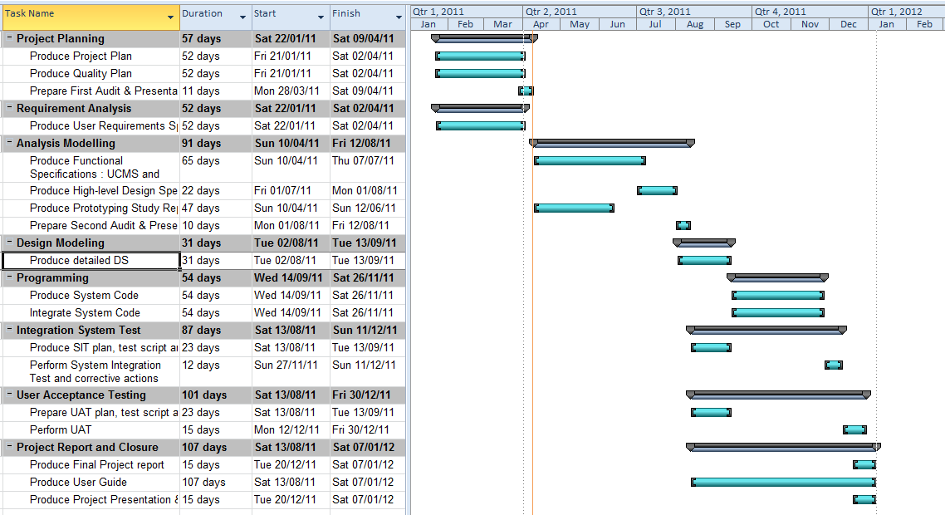
Project Plan – Gantt Chart

Slide 18
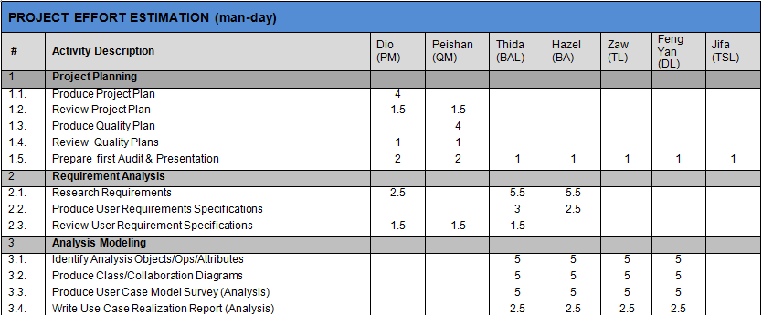
Project Plan – Effort Estimation

Slide 19
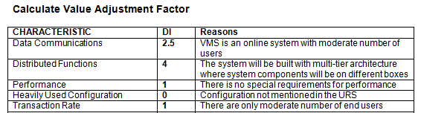
Project Plan – Effort Calculation by FPC
Unadjusted Function Point Count Summary
ITEM | LOW | AVERAGE | HIGH | TOTAL
External Input | 27x3=81 | 2x4=8 | 0x6=0 | 89
External Output | 3x4=12 | 0x5=0 | 0x7=0 | 12
Internal File | 13x7=91 | 0x10=0 | 0x15=0 | 91
Interface File | 0x5=0 | 0x7=0 | 0x10=0 | 0
External Inquiry | 6x3=18 | 0x4=0 | 0x6=0 | 18
Unadjusted Function Points |  |  |  | 210
Adjusted Function Point Count Summary
Adjusted Factor = 0.65 + 0.01 * 23 | 0.88
Adjusted FPC = Unadjusted FPC * Adjusted Factor | 184.8

Slide 20
Project Plan – Effort estimation by COSTAR 7
Programming language | Java
Translation factor | 29
Lines of Code = Translation factor * FPC = 29 * 184.8 * (1 + Breakage) = 29 * 184.8 Note: (i) % Breakage = 0 ( It is assumed that requirement will not change) (ii) The system will not reuse any existing software | 5359 SLOC
Development Effort = | 20.3 man-months
Schedule = | 11.0 months
Refer to Appendix A for more details

Slide 21
PROJECT Progress
Volunteer Management System

Slide 22
Project Progress
No | Activity | Planned Start Date | Planned End Date | Actual Start Date | Actual End Date | Planned Effort | Actual Effort | Task Status | Comments
1 | Project Planning
1.1 | Produce Project Plan | 21 Jan 2011 | 02 Apr 2011 | 20 Feb 2011 | 09 Apr 2011 | 7 | 9 | Done | Requirements gathering issues.
1.2 | Produce Quality Plan | 21 Jan 2011 | 02 Apr 2011 | 20 Feb 2011 | 05 Apr 2011 | 6 | 6.025 | Done | Makes changes based on Audit Meeting feedback
1.3 | Prepare First Audit & Presentation | 21 Jan 2011 | 02 Apr 2011 | 03 Apr 2011 | 09 Apr 2011 | 9 | 9 | Done
2 | Requirement Analysis
2.1 | Produce User Requirements Specifications | 22 Jan 2011 | 02 Apr 2011 | 20 Jan 2011 | 02 Apr 2011 | 18 | 13.6875 | Done
3 | Analysis Modelling
3.1 | Produce Functional Specifications : UCMS and UCRR (Analysis) | 10 Apr 2011 | 07 Jul 2011 |  |  | 38 |  | Open
3.3 | Produce Prototyping Study Report | 10 Apr 2011 | 12 Jun 2011 |  |  | 17.5 |  | Open

Slide 23
Management Challenges
Volunteer Management System

Slide 24
Management Challenges
No | Challenge | Description | Solution
1. | Communications | Difficulty to gather all members for discussions. | Online meeting via Skype To fix a weekly meeting time
2. | Requirements Gathering | Client only wants a small set of requirements. | Seek lecturers advice Proposed merging of requirements
3. | Task Control | Not able to meet deadline on time. | To log time log To hold meetings to track status
4. | Low Quality of Work | Deliverables not up to standard. | Perform reviews Conduct briefing and demo on required items

Slide 25
High Level Architecture
Volunteer Management System

Slide 26
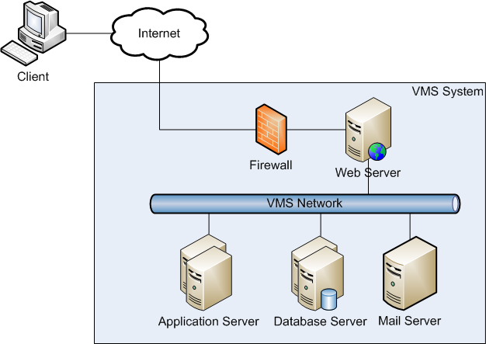
High Level Architecture –Architecture Overview

Slide 27
High Level Architecture –Architecture Overview
Web Server
Apache 2.2
Apache Load Balancer (JK module)
Application Server
Tomcat 6.0
Database Server (RDBMS)
Microsoft SQL Server 2008
Mail Server
POP Mail server (eg. Gmail)

Slide 28
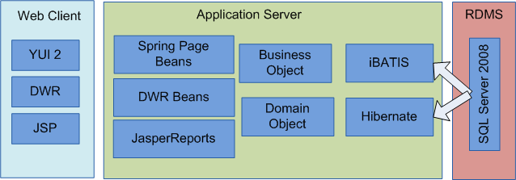
High Level Architecture – Overview of Components

Slide 29
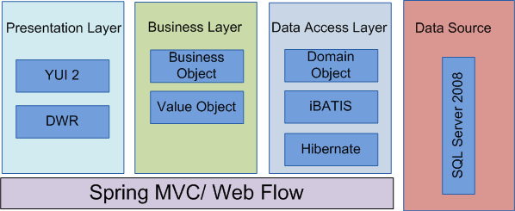
High Level Architecture – Framework Overview

Slide 30
Transition to Next Stage
Volunteer Management System

Slide 31
Transition to Next Stage – Where are we now?
Project Planning
Analysis and Design
Prototyping
Use Case Modeling
Use Case Realisation Report
High-level System Design
Software Architecture
Transition Strategy from Analysis to Design
Project Management

Slide 32
Transition to Next Stage – What do we plan to do?
No | Task | Description | In-Charge
1. | Prototyping | User interface prototyping Technical prototyping | Feng Yan, Jifa Zaw
2. | Use Case Modeling | Use case model survey | Thida, Hazel
3. | Use case realisation report | Use case realisation report | Thida, Hazel
4. | Software Design | High level software architecture design document | Zaw
5. | Transition Strategy from Analysis to Design | Transition Strategy from Analysis to Design | Zaw
6. | Project Management | Transition Strategy from Analysis to Design | Dio

Slide 33
Question & Answer

Slide 34
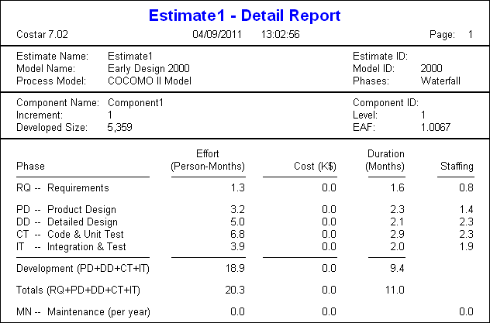
Appendix A : COCOMO detail report

